Slide 1

ELL Leadership Academy
Karina E. Chapa, M.Ed.
Language Proficiency, Biliteracy and Cultural Diversity Director
kchapa@esc1.net
Twitter @esc1bilingual @bilingualpride

Slide 2
The Power of acceleration
Remediation vs Acceleration

Slide 3

Session Objectives
Content Objective
Today I will explore the differences between remediation and acceleration. I will also reflect on how equity plays a role in GT programs.
Language Objective
Today I will discuss with my peers the differences between remediation and acceleration. I will also create a plan of action to ensure equitable services in our GT program.

Slide 4

The Power of Acceleration: Scenario 1
Gap will widen
50 mph
25 mph

Slide 5
The Power of Acceleration: Scenario 2
Gap will remain the same
50 mph
50 mph

Slide 6
The Power of Acceleration: Scenario 3
Gap will eventually close
50 mph
75 mph

Slide 7
ELL Progress
Typical Native Speaker
50th percentile in L1
One year progress = 10 months
7
6
5
4
3
2
English Learners
25th percentile in L2
1+ year progress = 10 months
1
(Thomas & Collier, 2001)
http://www.crede.ucsc.edu/research/llaa/1.1_final.html

Slide 8
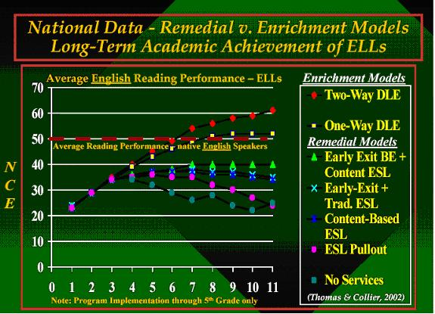
W. Thomas and V. Collier, 2002

Slide 9
ELL + GT = Equity

Slide 10

www.gtequity.org

Slide 11
Jigsaw Reading

Slide 12
Jigsaw Reading
Identifying ELLs in Gifted and Talented Programs
By Sam Savage
Introduction (Paragraphs 1-3)
Introduction (Paragraphs 4-6)
The Role of Public Schools
Use of IQ Tests
Recommendations for Identifying GT ELLs
Recommendations for Future Research

Slide 13
Reflection
If we don’t provide GT services to the best and the brightest from this rapidly growing population, where will the leadership and role models come from?

Slide 14

ocrdata.ed.gov
How does your district compare to the Region?
What inequities exist in your GT population?

Slide 15

Guess Who?
High Achiever
Gifted Learner
Creative Thinker
1
2
3

Slide 16
What Can We Do?
Create a task force
Identify members
Define purpose of task force
Provide training
Book studies: poverty, ELL, twice exceptional, cultural diversity
Validity of assessments

Slide 17
Session Objectives
Content Objective
Today I explored the differences between remediation and acceleration. I also reflected on how equity plays a role in GT programs.
Language Objective
Today I discussed with my peers the differences between remediation and acceleration. I also created a plan of action to ensure equitable services in our GT program.

Slide 18
ELL Accountability
Indexes, Safeguards and PBMAS

Slide 19
Session Objectives
Content Objective
Today I will analyze different accountability systems and the impact they have on the instruction of English Language Learners.
Language Objective
Today I will discuss how different accountability systems impact my school and my district.

Slide 20
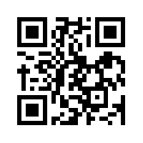
State Accountability
Anticipation Guide
kahoot.it
create.kahoot.it

Slide 21
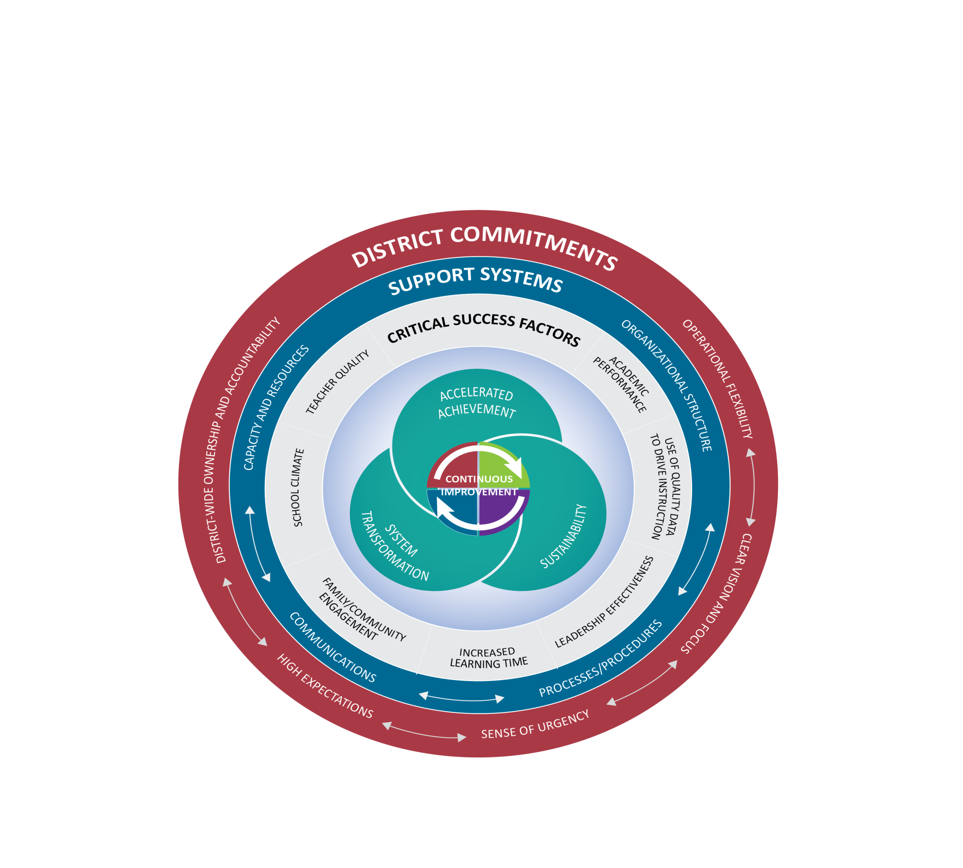
Texas Accountability Intervention System (TAIS)
Notes:
Presenter Talking Points:
The Texas Accountability Intervention System is a research based approached to school improvement that engages the district and school in the improvement process. The framework outlines five systemic components regarding district-level commitments, four support system components to be implemented at both the district and campus levels, and seven factors know to be critical to campus success. Planning for continuous improvement through the lens of these District Commitments, Support Systems and Critical Success Factors will result in the outcomes of accelerated achievement, sustainability, and system transformation.
The Framework for district and school support was developed collaboratively between the TEA and TCDSS. Local ESCs continue to develop tools and support for districts and campuses that align with framework that drives continuous improvement.
All of these elements are part of a healthy system for improvement. It takes each part of the system operating together for school success.
I have a short video to share with you that gives an overview of this framework.

Slide 22
Data
Process
Reporting
State
Districts & Campuses
IR or Met Standard
Indexes & Safeguards
Data Analysis
Needs Assessment
Targeted Improvement
Plan with
Progress Reports
Federal (ESEA Waiver)
Districts & Campuses
Priority and Focus
Safeguards
Implement & Monitor
Improvement Plan
Performance-Based Monitoring (PBM)
Districts
PBMAS
Notes:
Presenter Talking Points:
The continuous improvement process has been designed in such a way that regardless of what accountability rating initiates the engagement to the framework, the continuous improvement process is universally applicable in getting the work done in a targeted way.
Optional Activity: Before the break, give teams a couple minutes to write down or discuss 1 question they may have swirling around at this point and 1 thing that is square in their thinking.
Optional Activity: Share out could be used as a way to welcome group back from the break.

Slide 23
2017 INDEXES AND SAFEGUARDS
State and Federal Accountability Systems

Slide 24
State Accountability Videos
English: https://youtu.be/cbEgrdijuc8
Spanish: https://youtu.be/eidlyApBSkY

Slide 25
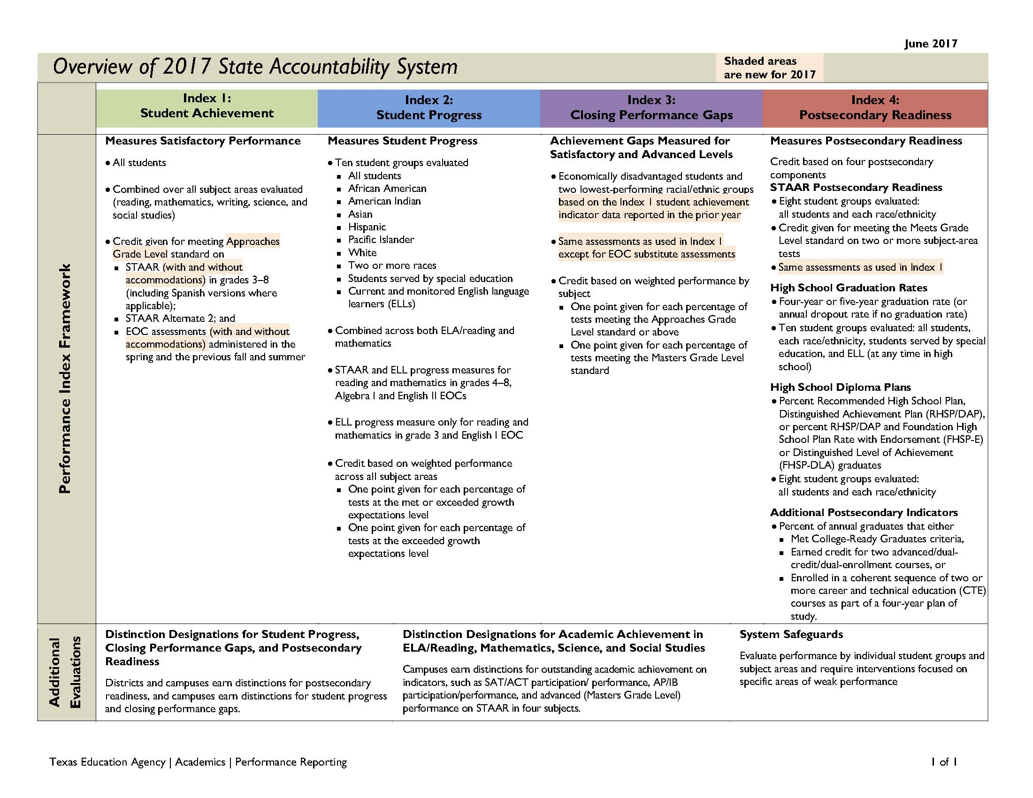

Slide 26
Index Framework

Slide 27
Index 1

Slide 28
Index 2

Slide 29
Index 3

Slide 30
Index 4

Slide 31

Indexes and safeguards reports
https://rptsvr1.tea.texas.gov/perfreport/account/

Slide 32
Region One ESC

Slide 33
Index 1

Slide 34
Index 1
-16%
-18%
-10%

Slide 35
Index 2
-1%

Slide 36
Index 2
-2%
+1%
-3%
+1%
-2%
+1%

Slide 37
Safeguards

Slide 38
2016 PBMAS
Performance Based Monitoring Analysis System

Slide 39
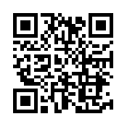
PBMAS Reports
https://goo.gl/RKDUya

Slide 40
Special Education
NCLB Title I Part A At Risk
Program Performance
&
Program Effectiveness
Bilingual ESL
NCLB Title I Part C Migrant
CTE

Slide 41
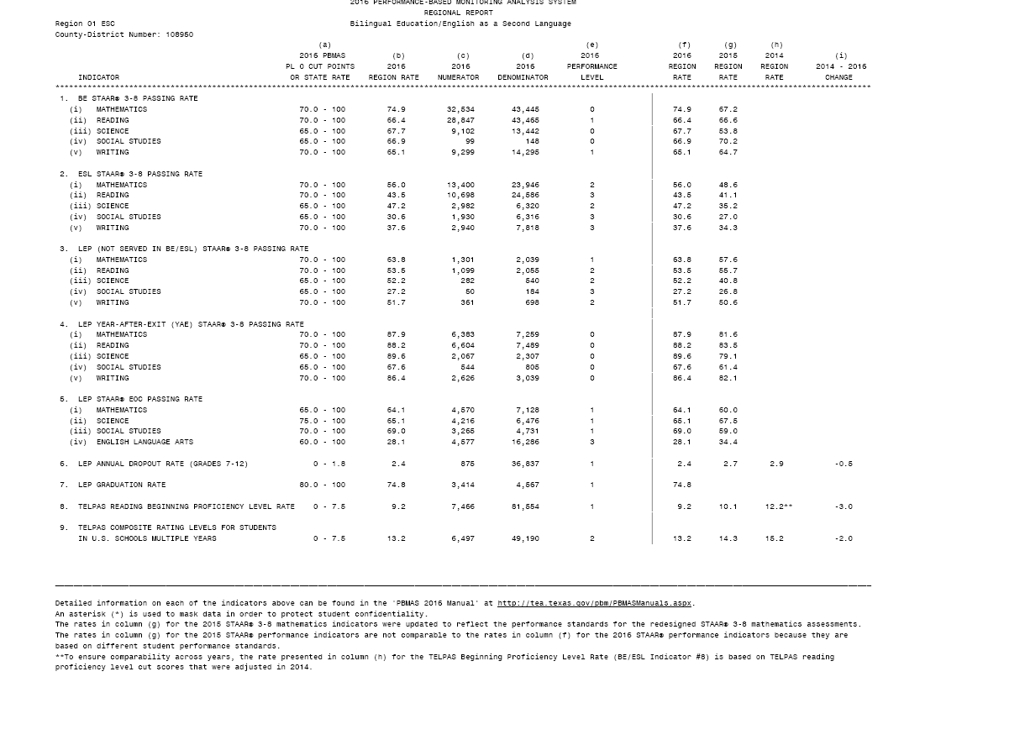
BE/ESL (Indicators 1-9)
ELLs are advancing academically as per STAAR performance
ELLs Not Served in BE or ESL are advancing academically as per STAAR performance
ELLs are graduating and not dropping out of school
ELLs grades 2-12 are not scoring beginning proficiency level for two consecutive years on TELPAS Reading
ELLs grades 5-12, 5 + years demonstrate progress on TELPAS Composite rating and are not continuing to be rated B or I

Slide 44
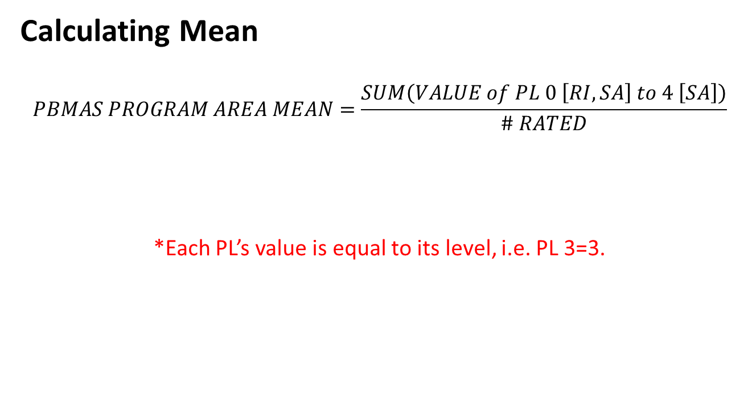
2016-2017 Staging Framework

Slide 45
2016-2017 Staging Framework
Mean Ranges by Program Area for a 90%/10% Distribution
STAGE | BE/ESL | CTE | TITLE | SPED
1 | 0.2 – 1.0 | 0.2 – 0.8 | 0.2 – 0.9 | 0.2 – 1.3
2 | 1.1 – 1.6 | 0.9 – 1.1 | 1.0 – 1.5 | 1.4 – 1.5
3 | 1.7 – 1.9 | 1.2 – 1.4 | 1.6 – 2.2 | 1.6 – 1.8
4 | 2.0 – 3.0 | 1.5 – 2.1 | 2.3 – 3.0 | 1.9 – 2.2

Slide 46
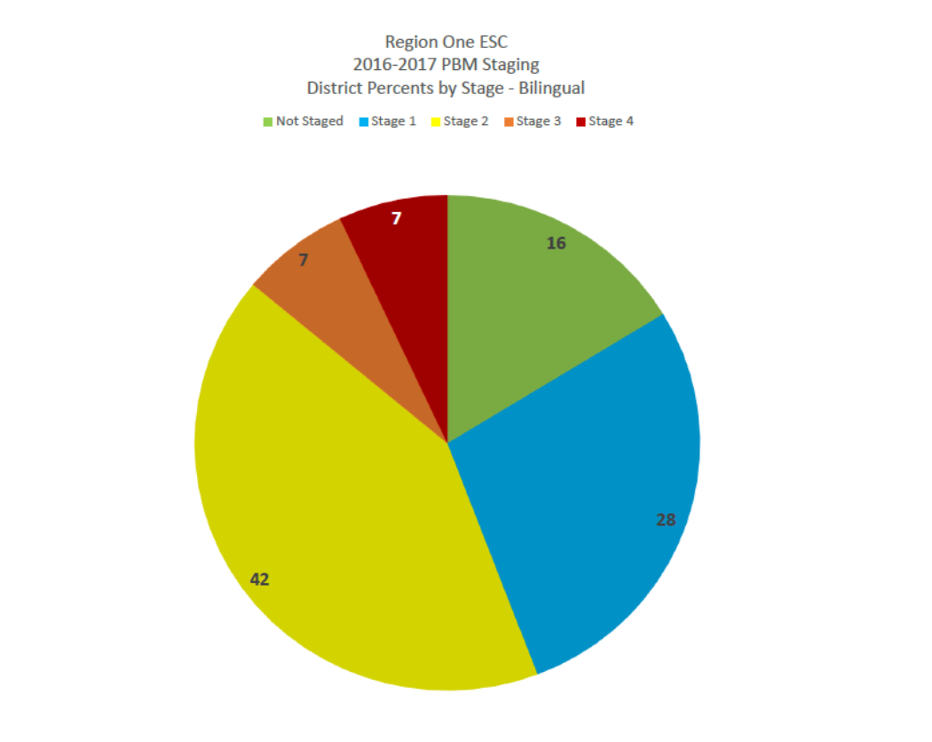
Notes:
11:15 AM

Slide 47
Data
Process
Reporting
State
Districts & Campuses
IR or Met Standard
Indexes & Safeguards
Data Analysis
Needs Assessment
Targeted Improvement
Plan with
Progress Reports
Federal (ESEA Waiver)
Districts & Campuses
Priority and Focus
Safeguards
Implement & Monitor
Improvement Plan
Performance-Based Monitoring (PBM)
Districts
PBMAS
Notes:
Presenter Talking Points:
The continuous improvement process has been designed in such a way that regardless of what accountability rating initiates the engagement to the framework, the continuous improvement process is universally applicable in getting the work done in a targeted way.
Optional Activity: Before the break, give teams a couple minutes to write down or discuss 1 question they may have swirling around at this point and 1 thing that is square in their thinking.
Optional Activity: Share out could be used as a way to welcome group back from the break.

Slide 48

Data Analysis
WHAT
Needs Assessment
WHY
Implement & Monitor
Improvement Plan
HOW
DATA ANALYSIS
Notes:
Facilitator Talking Points:
As mentioned in the opening, the purpose of this training is not to review all required interventions, rather to focus on the most important aspect of the work: engaging in the TAIS continuous improvement process.
Now we are going to take a look at the first quadrant of the continuous improvement process, data analysis.

Slide 49
Steps for Data Analysis
1. Create Inventory of Data Sources
2. Analyze Trends and Patterns
3. Identify the Problem Area
4. Create a Problem Statement
5. Verify Problem Statement

Slide 50

“A problem properly stated is half solved.”
John Dewey
Notes:
Facilitator Talking Points:
Provide the participants time to read this quote. Then inform them that as we move through each section, especially data analysis and needs assessment, the underlying message in this quote w section think about what this quote means to each step in the continuous improvement process.
Facilitation Notes:
Provide the participants time to read this quote.

Slide 51
A well written problem statements is…
Criteria | Y/N
Substantiated by facts/data
Written objectively
Uses concise language
Includes specific details (who, what, when, where)
Focuses on a single, manageable issue
Has relevance to our campus
Avoids causation or assigning solutions
Notes:
Facilitator Talking Points:
To help support the development of a problem statement, the following check list may also be used with your team. Notice that the criteria maintain objective and factual. Again, at this point, we are only exploring what the problems are.
Being that the requirement to develop a targeted improvement plan is to focus on the areas of low performance, it’s possible that teams may only identify 2-3 problem statements.
Keep in mind that, the rest of the plan will be developed further once the problem statements have been generated. At this point in the process you are bringing clarity to what issues need to be addressed in your plan.
Refer to the Problem Statement Checklist handout. This is a resource that you can use in the development of your problems statements.
With this criteria in mind, let’s review a sample problem statement to see if it is well written.
Facilitation Notes:
Have participants access the problem statement checklist
Reiterate that this practice is to become very clear about WHAT the problem are is, not why or how to address it.
Give teams time to review each criteria
Handout 7: Problem Statement Checklist

Slide 52

PROBLEM STATEMENT QUALITY CHECK
ELLs have a 50% pass rate in reading due to a lack of parental involvement
Notes:
Facilitator Talking Points:
Explain that as a group, you will assess the above problem statement according to the criteria in the tool.
Ask that the group help as you assess the problem statement according to each piece of the criteria by giving a “thumbs up,” “thumbs down,” or something in between.
Tell them that the end goal will be to produce an even better problem statement.

Slide 53
PROBLEM STATEMENT QUALITY CHECK
ELLs have a 50% pass rate in reading due to a lack of parental involvement
ELLs have a 50% pass rate in reading
REVISED PROBLEM STATEMENT
Notes:
Facilitator Talking Points:
Here is an example of a revised problem statement that addresses the criteria that were not followed previously.
Perhaps quickly run the new problem statement through the criteria to illustrate – especially highlight no causation and one manageable issue.
Facilitation Notes:
Encourage sharing out, if appropriate.
If the group does not raise the point, explain that when we see the words “due to,” we are assigning blame.
OPTIONAL ACTIVITY
Perhaps give the group some time to re-write the problem statement using the lessons learned from the criteria tool. Have them share out what they came up with. Allow the group to assess each one that is shared.
(7-10min)

Slide 54
Data Analysis
WHAT
Needs Assessment
WHY
Implement & Monitor
Improvement Plan
HOW
NEEDS ASSESSMENT
Notes:
Facilitation Notes:
Transition slide for next step in the process.

Slide 55
Steps for Needs Assessment
Root Cause Analysis
Additional Data Sources
Select Root Cause

Slide 56

WHY?
Notes:
Facilitator Talking Points:
The purpose of the root cause analysis is to identify possible reasons WHY the problem is occurring. Digging beneath the surface of the common assumptions that are often made when attempting to fix the problems we see. Understanding the root cause will lead to a more effective plan that addresses the real issues and is not based on assumptions.
Once we have analyzed the data and gained a clear understanding of what the data says through the development of problem statements, we can effectively begin to drill into WHY these problems exist. The needs assessment, or root cause analysis, will help us understand WHY the problems, or gaps in data, exist.
The root cause is significant because it helps answer WHY the problem (or gap based on data) exists. Determining a reason WHY a gap exists, especially one that isn’t an obvious reason why, gives us insight as to HOW best to address the problem in the planning phase of the process.
The root cause is a hypothesis for the problem statement. This hypothesis sets the context for us to treat the deeper issues, below the surface of the problem statement. This hypothesis is a data grounded, proposed reason why this problem is occurring. However, there are no absolutes when it comes to determining whether or not the “right” root cause has been identified.
The root cause analysis process allows one to drill deep below the surface reasons why. Drilling deep enough helps better identify the root cause, thus allowing us to select the best possible strategy later in the process.
Facilitator Note:
Acknowledge those who may already work with a root cause analysis process.

Slide 57
ROOT CAUSE ANALYSIS PROCESS
PROBLEM STATEMENT
ACTION 1:
  10, 5, 5
ACTION 2:
  Control vs No Control
ACTION 3:
  5 Whys
ROOT CAUSE
Notes:
Facilitator Talking Points:
The first phase of this analysis is called the 10, 5, 5
10, 5, 5---This is a group brainstorming process meant to begin conversations around the possible reasons WHY the problems or gaps exist.
This process establishes multiple hypothesis to a given problem statement.
The purpose of this activity is to stretch brainstorming beyond the surface level or common reasons “why.”
In a minute, starting with the drafted problem statement written on your poster, you’re going to be given time individually to come up with a list of reasons why the problem is occurring AND THEN YOU WILL BE GIVEN TIME TO WORK WHOLE GROUP TO COMBINE YOUR POSSIBLE REASONS WHY THE GAP EXISTS.
There are no wrong answers so record whatever possible reasons come to mind that problem is occurring. However, it’s important to note that data will need to be referenced in order to avoid subjectivity and opinion based reasons moving forward.
Handout 8: Root Cause Analysis activity

Slide 58
10
5
5
REASONS WHY
MORE
MORE
Notes:
Facilitator Talking Points:
Explain and follow activity steps below.
Activity Steps:
Step 1: Allow teams 5-7 minutes to come up with 10 reasons why the problem exists individually (don’t advance the slides until it’s time for the next step).
Let teams know when time is up and if they haven’t gotten to 10 reasons it’s ok. If they feel compelled to write more than 10 reasons, that’s ok too.
Step 2: Click to next step when time is up. Now come up with 5 more reasons why the problem exists.
Mention to them that it may be a little more difficult to come up with 5 more reasons. Encourage them to stretch their thinking and try to come with 5 more. 3-5 minutes
Step 3: Click to next step. Now come up with 5 more reasons why the problem exists. This may be getting more difficult which is the intention. Allow 3 more minutes for this part.
Acknowledge with teams that this may be hard to do after coming up with 15 reasons. The intention is to move past the obvious reasons and possible “finger pointing” that takes place when we think about why something isn’t working. Encourage them to do their best, there isn’t a right or wrong.
Now, allowing teams to work whole group, have them share their reasons with one another and record the reasons on one piece of paper.
Step 4: Ask the participants to take note of the reasons for which they currently have data to support their belief and which one’s need additional data.
Facilitation Notes:
Explain and follow activity steps
Emphasize the importance of following the timing within the protocol

Slide 59
ROOT CAUSE ANALYSIS PROCESS
PROBLEM STATEMENT
ACTION 1:
  10, 5, 5
ACTION 2:
  Control vs No Control
ACTION 3:
  5 Whys
ROOT CAUSE
Notes:
Facilitator Talking Points:
Often times we expend energy in solving issues that are beyond our direct control but perhaps we still have influence over.
In order to make urgent changes that have a strong impact, we want to focus our attention on what we can directly control.
So, in this next phase, you will sort through the list of 20 reasons and begin to decide which of those ideas can we control and which might we only have an influence over.

Slide 60
ROOT CAUSE ANALYSIS PROCESS
PROBLEM STATEMENT
ACTION 1:
  10, 5, 5
ACTION 2:
  Control vs No Control
ACTION 3:
  5 Whys
ROOT CAUSE
Notes:
Facilitator Talking Points:
The last phase to this process is called 5 Whys.
Once a consensus has been reached, the 5 Whys will provide an opportunity for teams to dig deeper into why the problem is occurring.
The last answer to the last question becomes the possible root cause.
Know that 5 is not a magic number, it’s possible your team may want to explore up to 7 “whys” and in other cases, only 3.
Let’s revisit our example...

Slide 61
Small Group Discussion
How can I use this information at my campus/district?
Why is it important?

Slide 62
Tickets Out
On a post-it, write a “Tweet” about something you learned today (120 characters or less).
Don’t forget to hash-tag it!

Slide 63
Thank you!
See you August 8th!
Karina E. Chapa, M.Ed.
Language Proficiency, Biliteracy and Cultural Diversity Director
kchapa@esc1.net
Facebook: Region One ESC Bilingual
Twitter @esc1bilingual @bilingualpride

